Slide 1
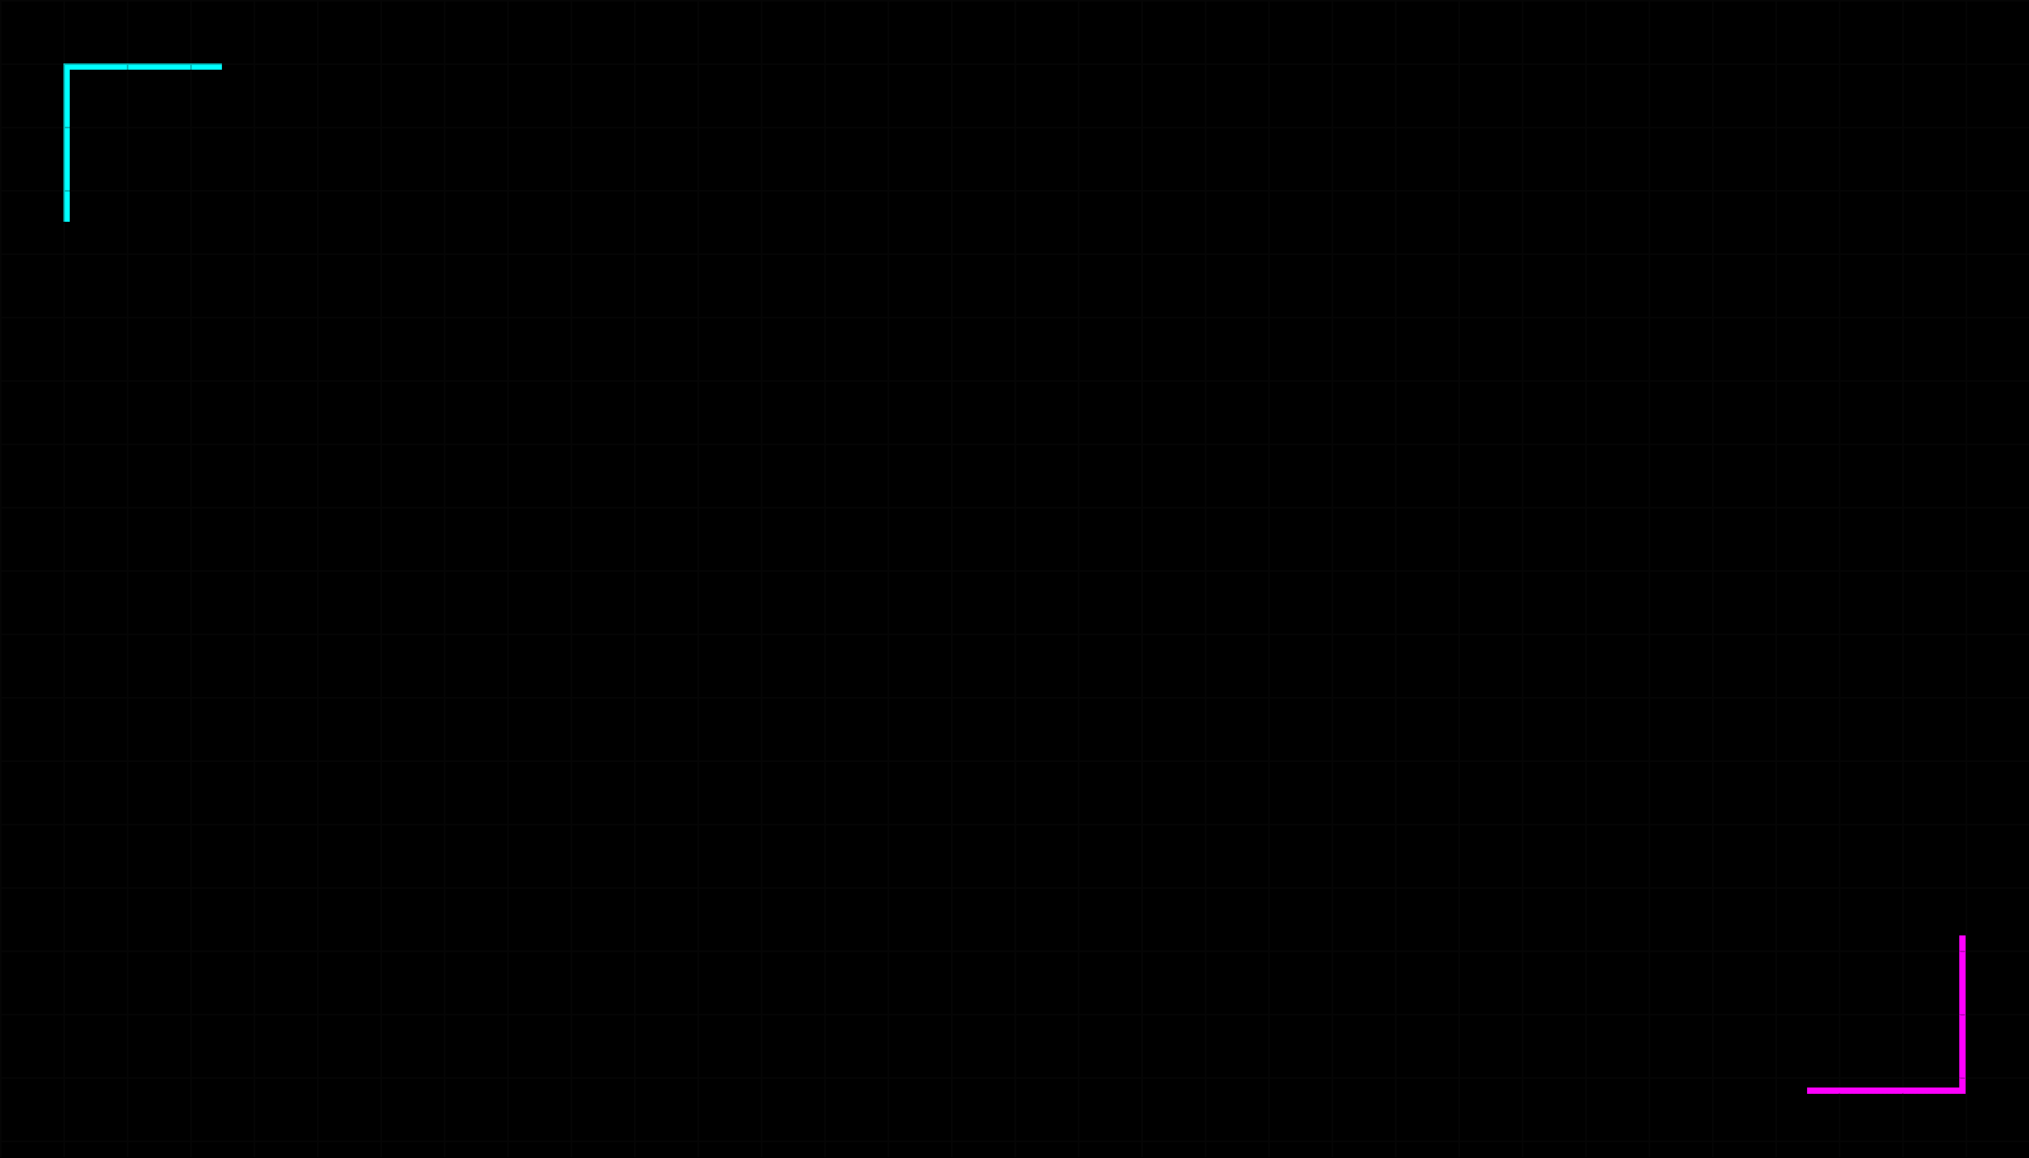

Module 08
Bias-Variance Tradeoff
The Goldilocks Principle of Machine Learning

Slide 2

The Goldilocks Problem
Why do models fail?
❄️
🥣
🔥
Too Simple
Just Right
Too Complex
Misses important patterns. (Underfitting)
Captures real patterns, ignores noise.
Memorizes random noise. (Overfitting)
The Goal: Find the Sweet Spot.

Slide 3

Underfitting
The Ruler & The Circle
>
Model is too simple to capture the underlying pattern.
>
Like trying to draw a circle using only a straight ruler.
>
Misses the signal entirely.
Symptoms
Training Score: LOW Test Score: LOW

Slide 4

Overfitting
The Memorization Trap
>
Model is too complex and memorizes noise.
>
Like a student who memorizes answers but fails the exam.
>
Fails to generalize to new data.
Symptoms
Training Score: VERY HIGH (99%) Test Score: LOW (60%)

Slide 5

The Sweet Spot
Balancing Bias and Variance
The Goal
The Reality
High performance on Training Data.
You cannot minimize both simultaneously.
High performance on Test Data.
Reducing Bias often increases Variance.
This is called Generalization.
Reducing Variance often increases Bias.
Strategy: Find the optimal point where Total Error is minimized.

Slide 6
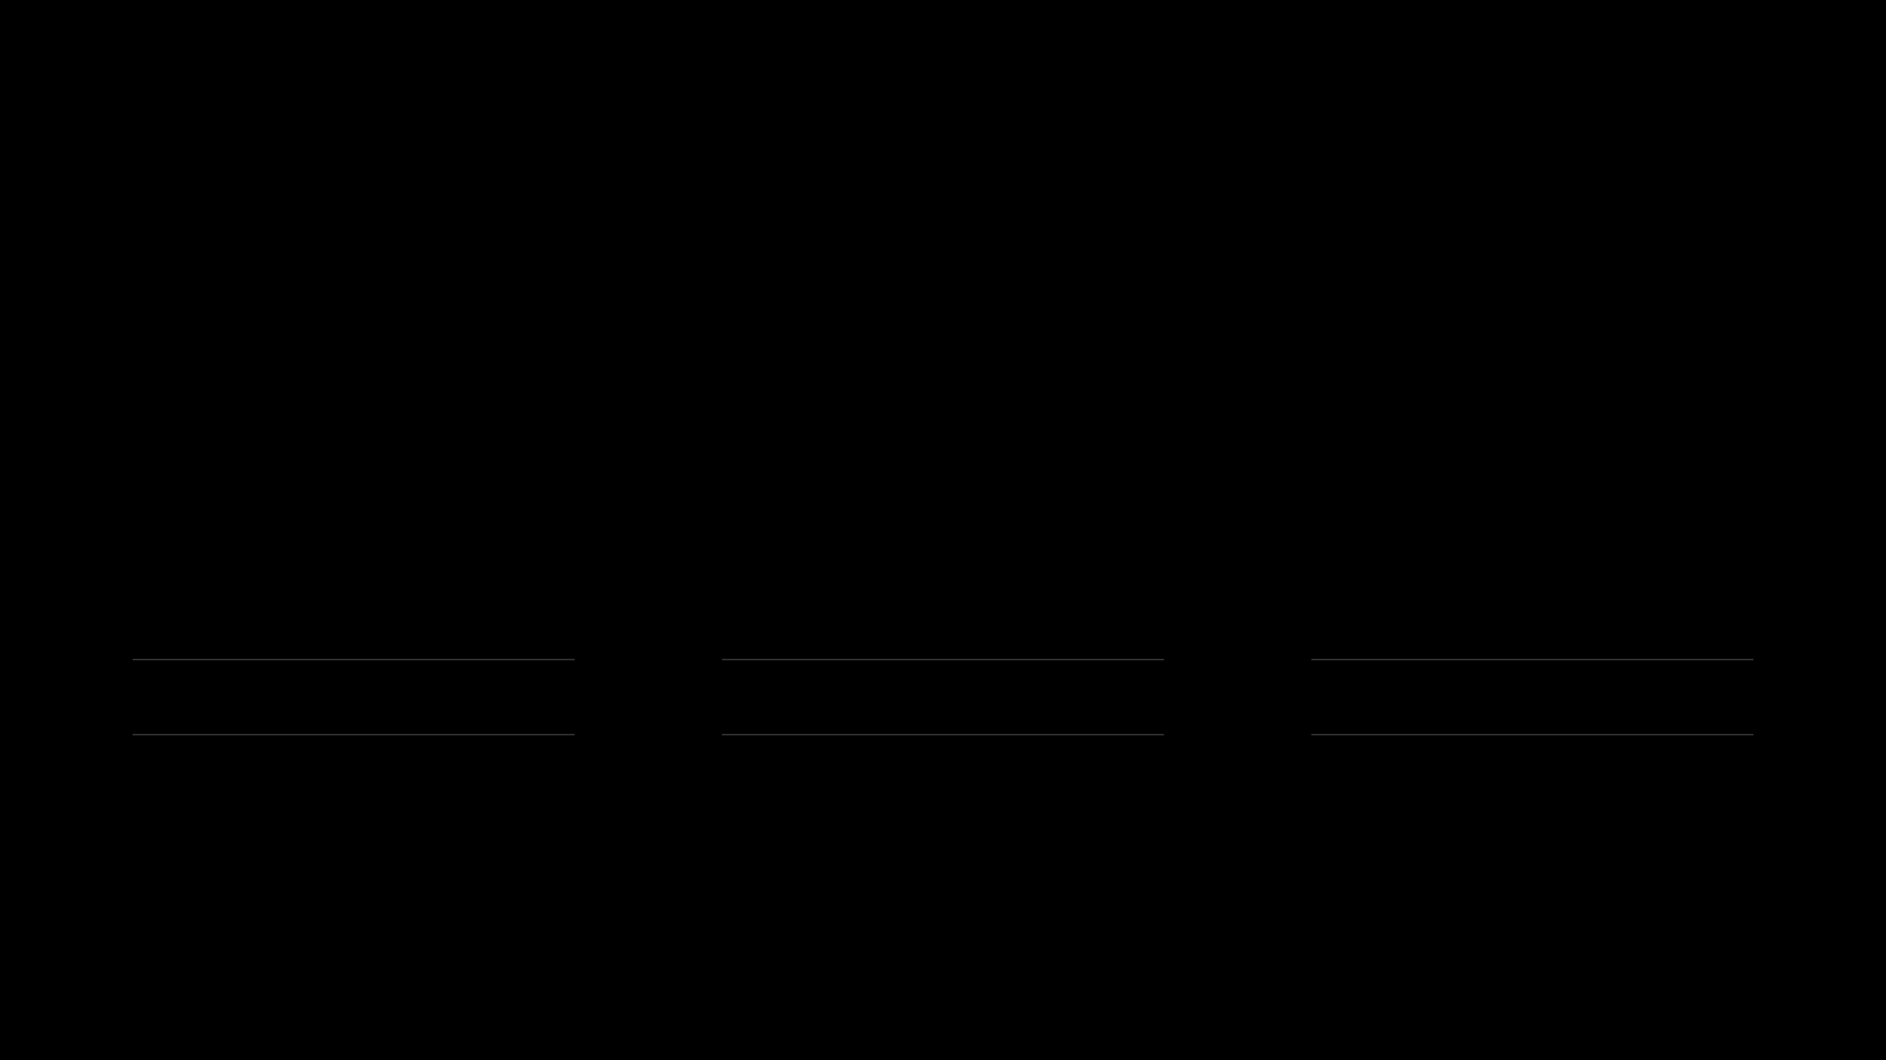
Visual Comparison
Which model wins?
Model A
Model B
Model C
"The Straight Line"
"The Smooth Curve"
"The Zig-Zag"
Training:
70%
Training:
85%
Training:
99%
Testing:
68%
Testing:
83%
Testing:
55%
TOO SIMPLE
WINNER
TOO COMPLEX

Slide 7
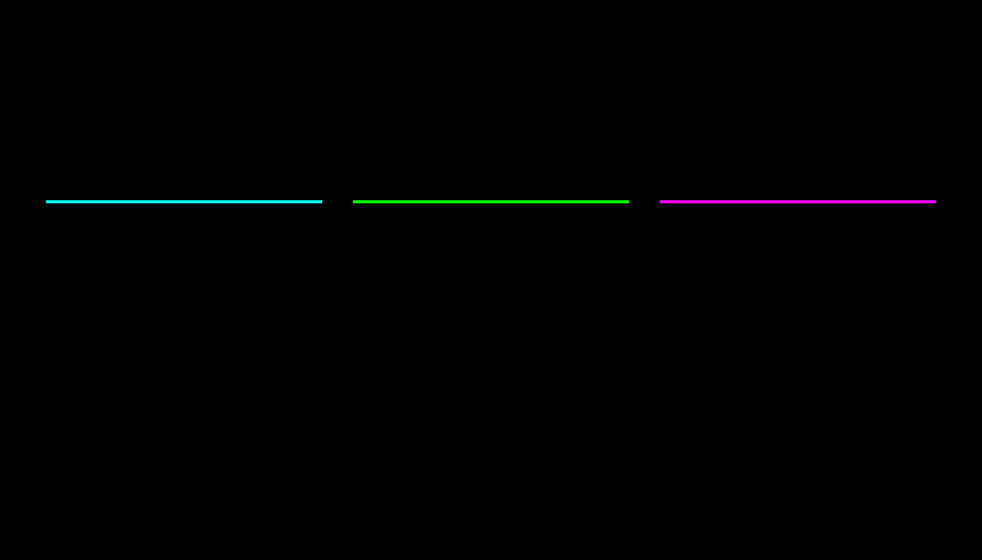
Real-World Example
Predicting House Prices
Degree 1 (Linear)
Degree 3 (Cubic)
Degree 15
"The Straight Line"
"The Smooth Curve"
"The Wild Wiggle"
Assumes price increases linearly with size. Misses the fact that prices plateau or accelerate. Result: Underfitting
Captures the natural market trend. Follows the data without reacting to every outlier. Result: Good Fit
Curve oscillates wildly to hit every single house price exactly. Predicts negative prices in between. Result: Overfitting
Lesson: More complexity ≠ Better model. The simplest model that works is best.

Slide 8
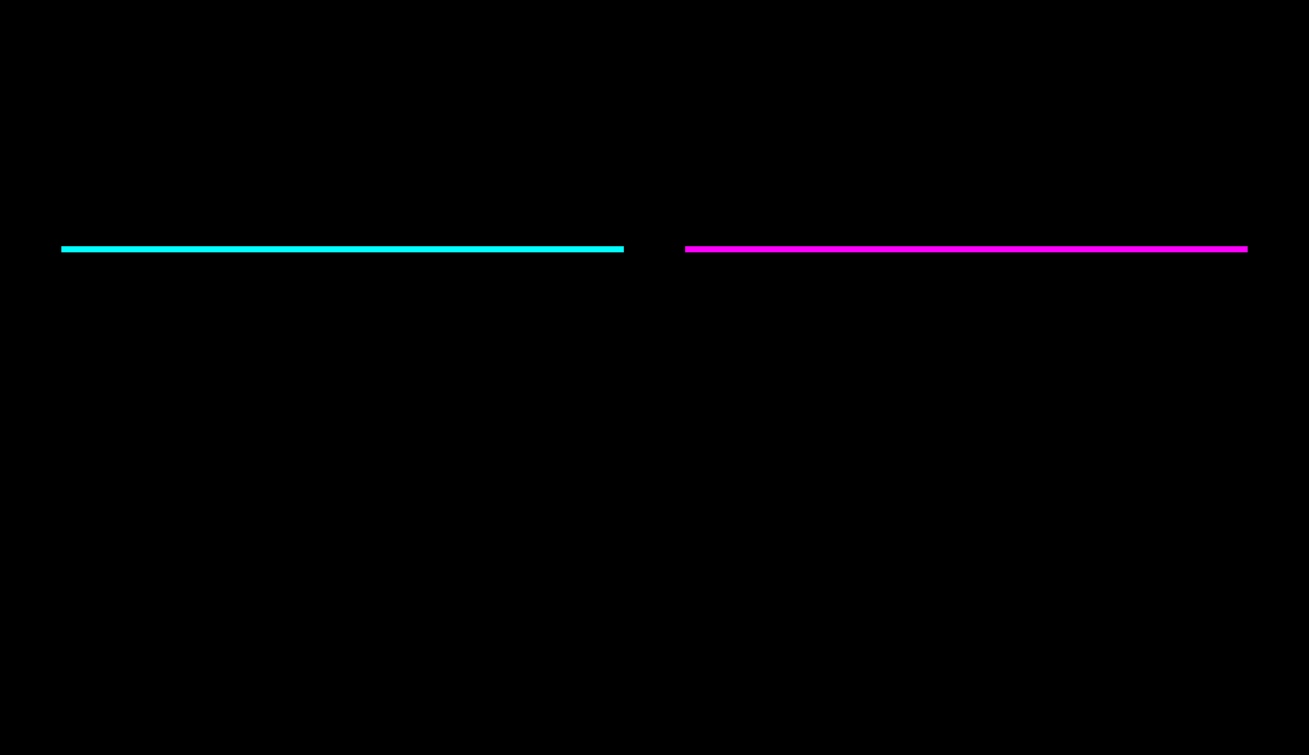
The Core Tension
Flexibility vs. Generalization
Less Flexible
More Flexible
VS
Makes strong assumptions about data shape.
Can fit complex patterns and wiggles.
Requires more data to tame.
More stable predictions.
Risk: Overfitting (High Variance).
Risk: Underfitting (High Bias).
"The art of ML is choosing the right level of flexibility."

Slide 9
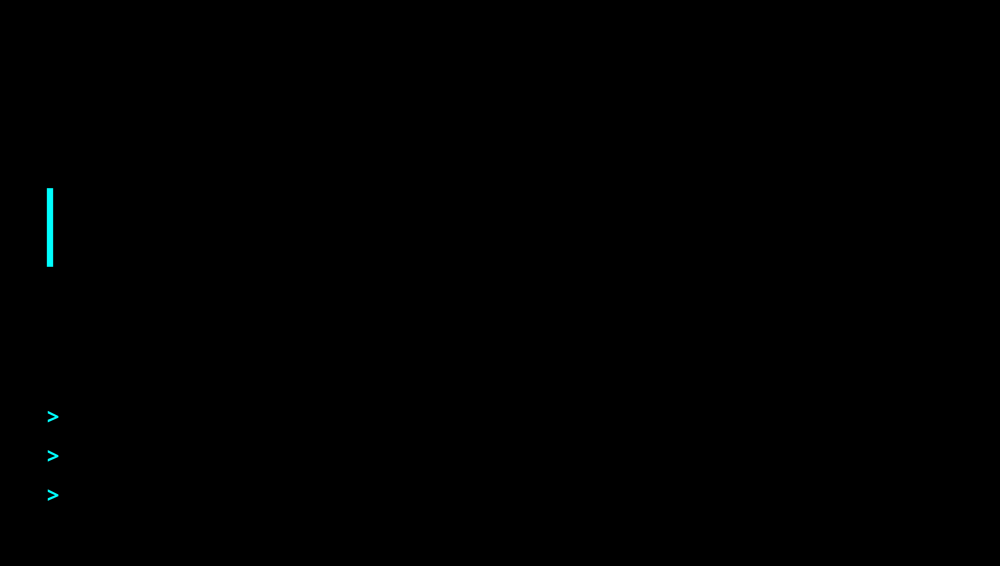
What is Bias?
Systematic Error
The error introduced by approximating a real-world problem with a simplified model.
High Bias =
Underfitting (Model is too simple)
Common Biased Assumptions
>
Assuming data is
Linear
when it's curved.
>
Using only
2 features
when 10 are relevant.
>
Ignoring interaction effects between variables.

Slide 10
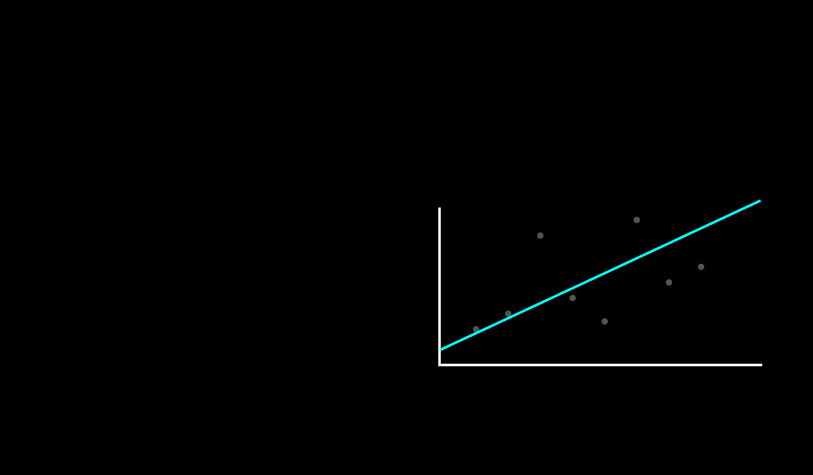
High Bias Scenario
The Salary Prediction Trap
The Setup
The Reality
Salary
Task: Predict Salary.
Input: Only "Years of Experience".
Model: Linear Regression.
Assumption: Salary grows linearly forever.
Years
Systematic Error: Misses the complexity.
Root Cause: Missing features (Education, Role, Location).

Slide 11
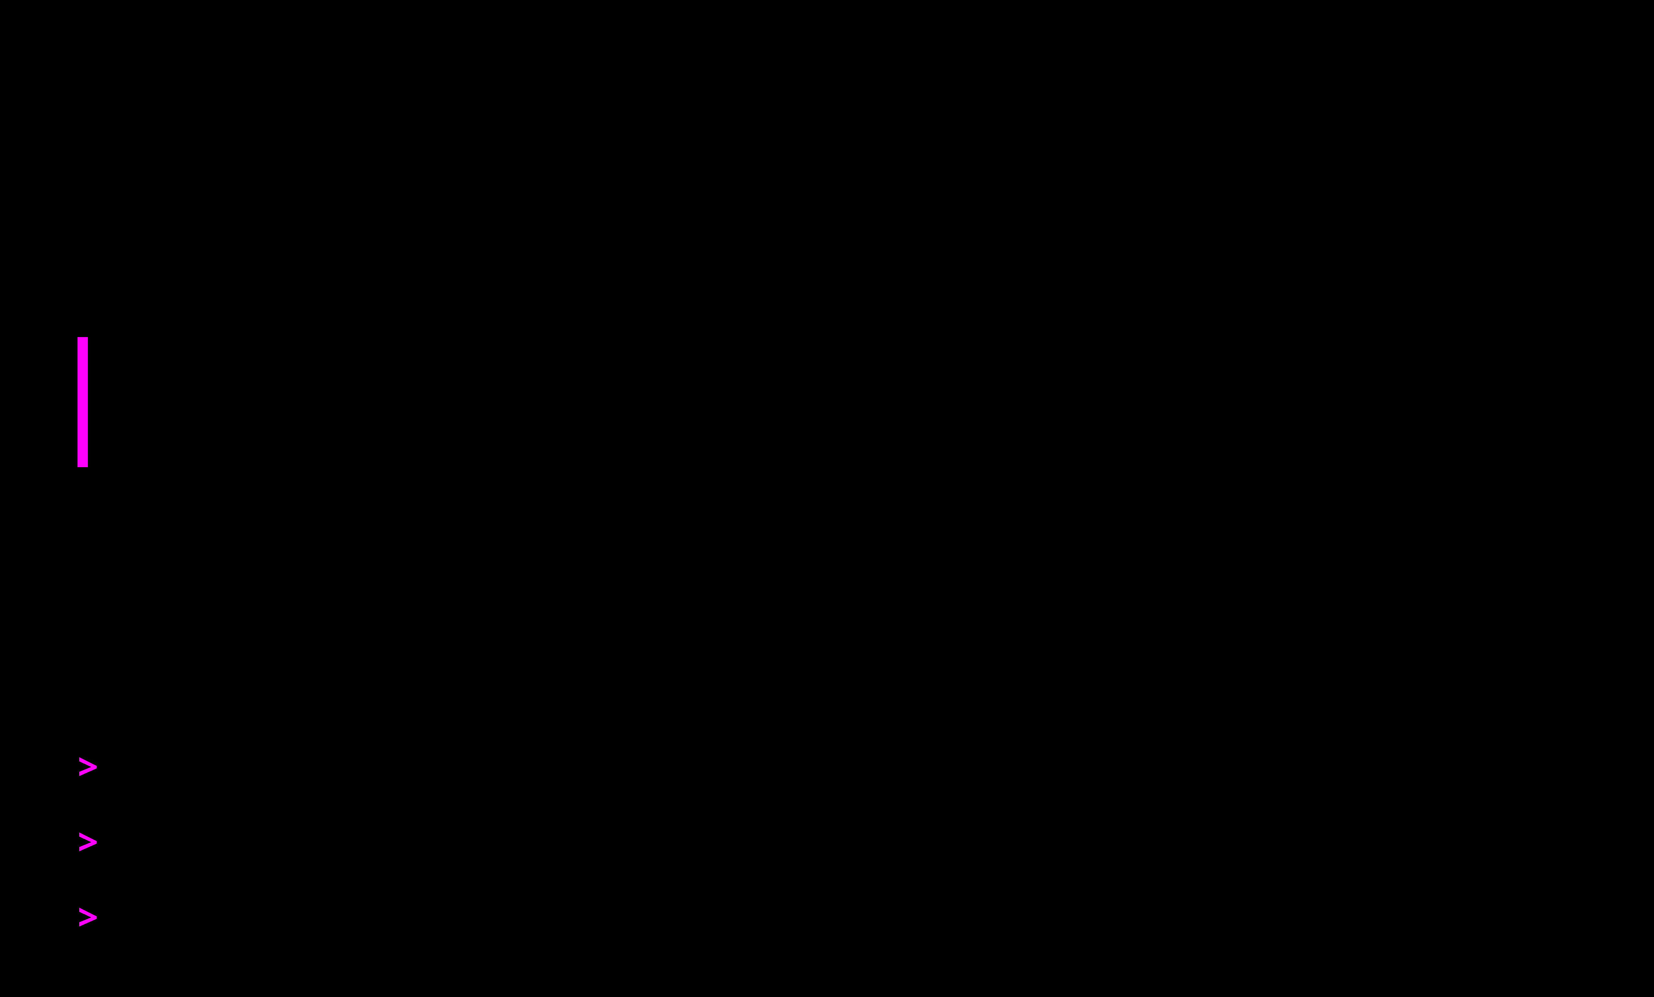
What is Variance?
Sensitivity to Noise
The amount by which the model would change if we estimated it using a different training set.
High Variance =
Overfitting (Model is too sensitive)
Characteristics of High Variance
>
Model captures
random noise
as if it were a pattern.
>
Drastically different predictions with slightly different data.
>
Perfect training score, but fails on new data.

Slide 12
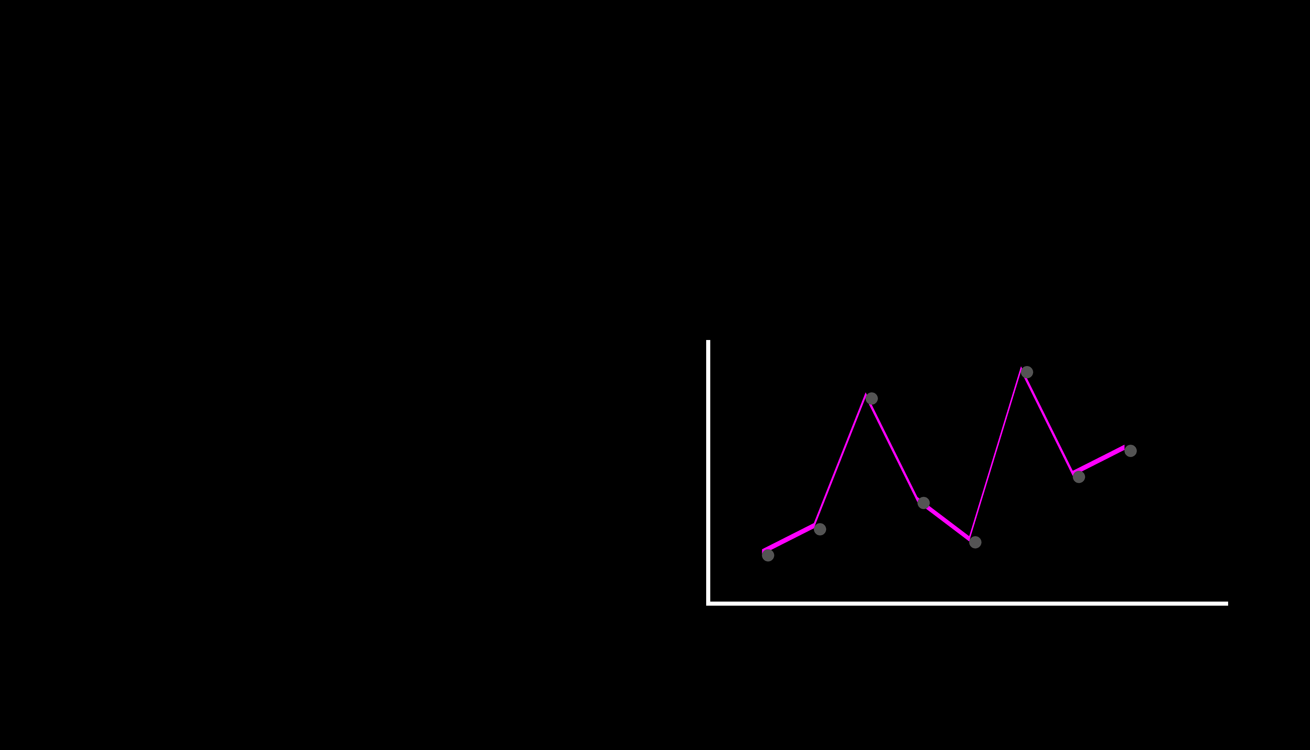
High Variance Scenario
The Noise Trap
The Setup
The Reality
Salary
Task: Predict Salary.
Input: Years + Shoe Size + Zip Code + Favorite Color.
Model: Degree 15 Polynomial.
Assumption: Every data point matters.
Years
Model memorizes the noise.
Root Cause: Too much complexity, not enough data.

Slide 13
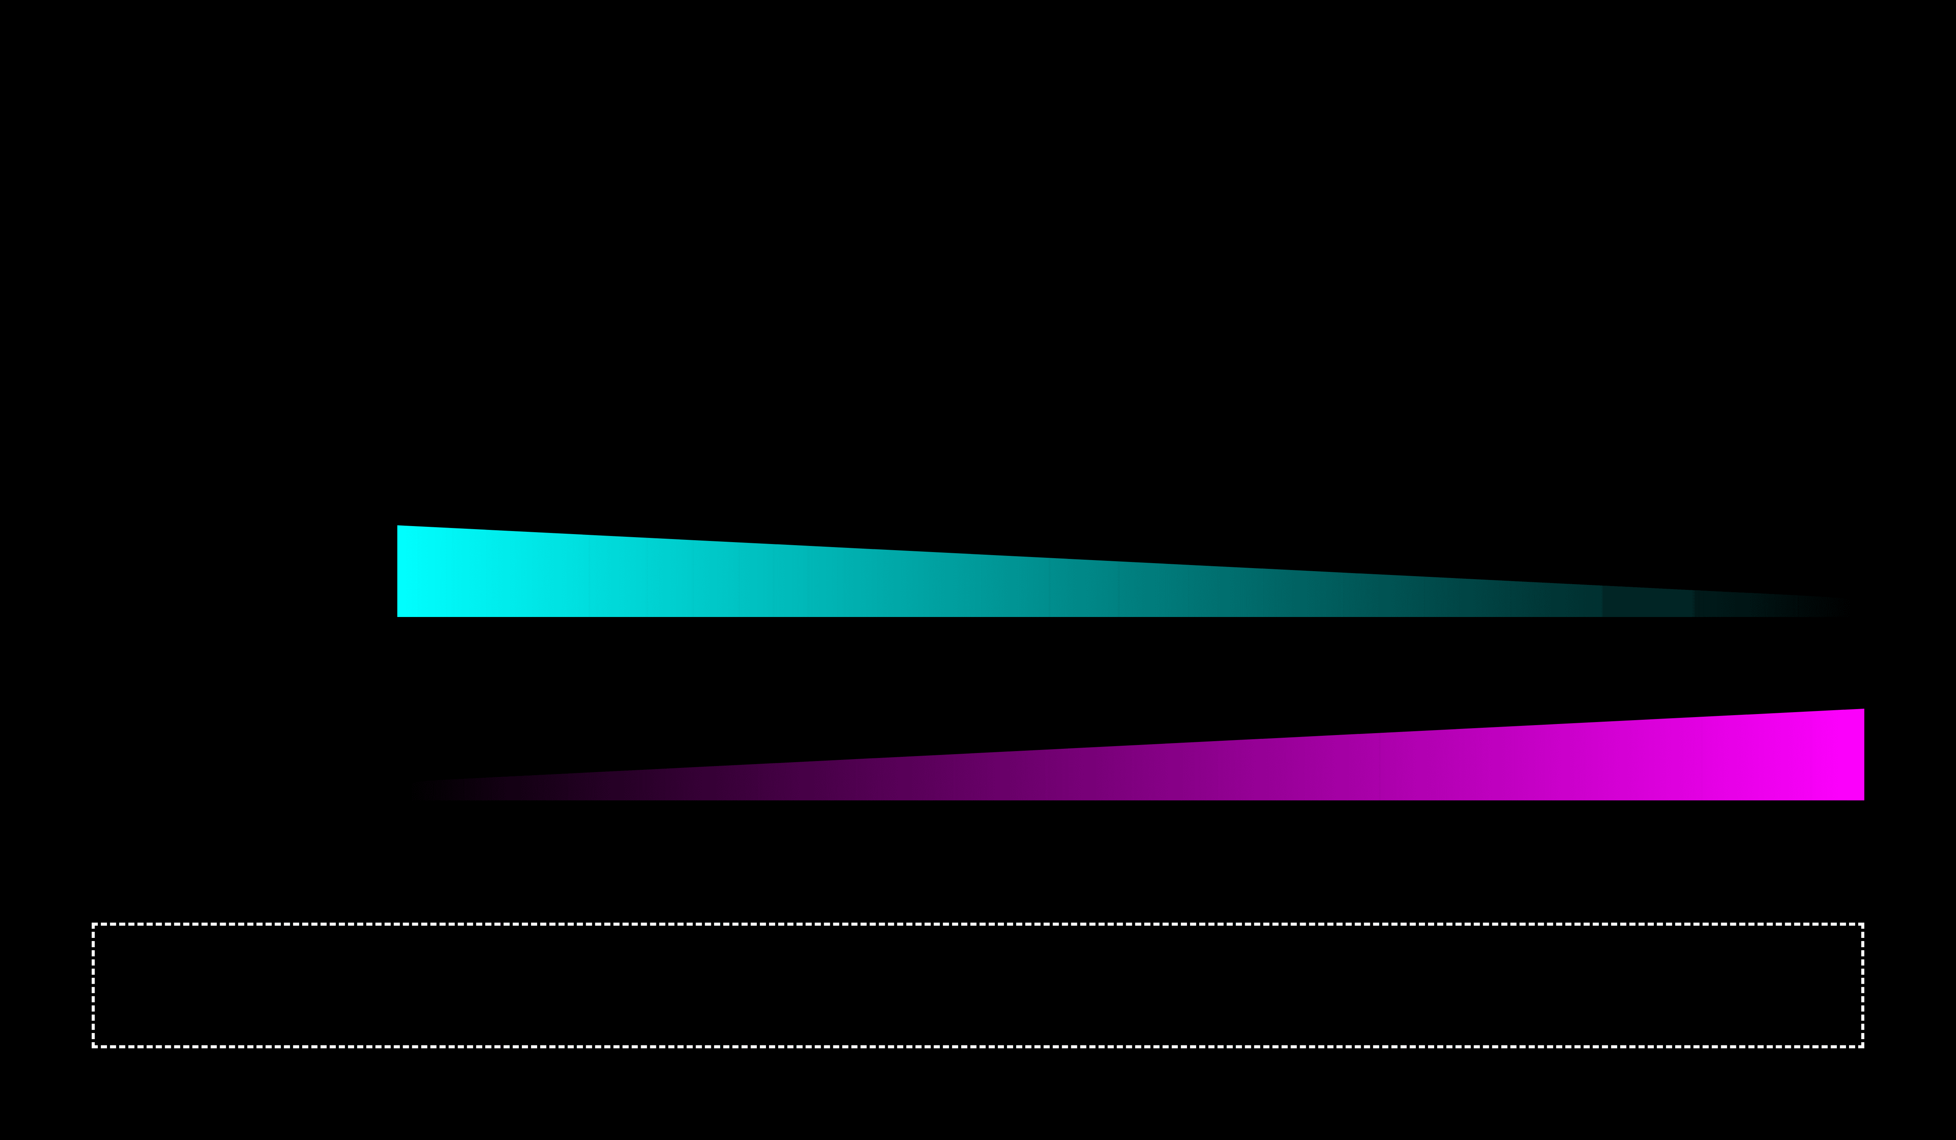
The Tradeoff
The Seesaw Relationship
Simple Model
Complex Model
Bias
HIGH
LOW
Variance
LOW
HIGH
Total Error is minimized somewhere in the Middle.

Slide 14
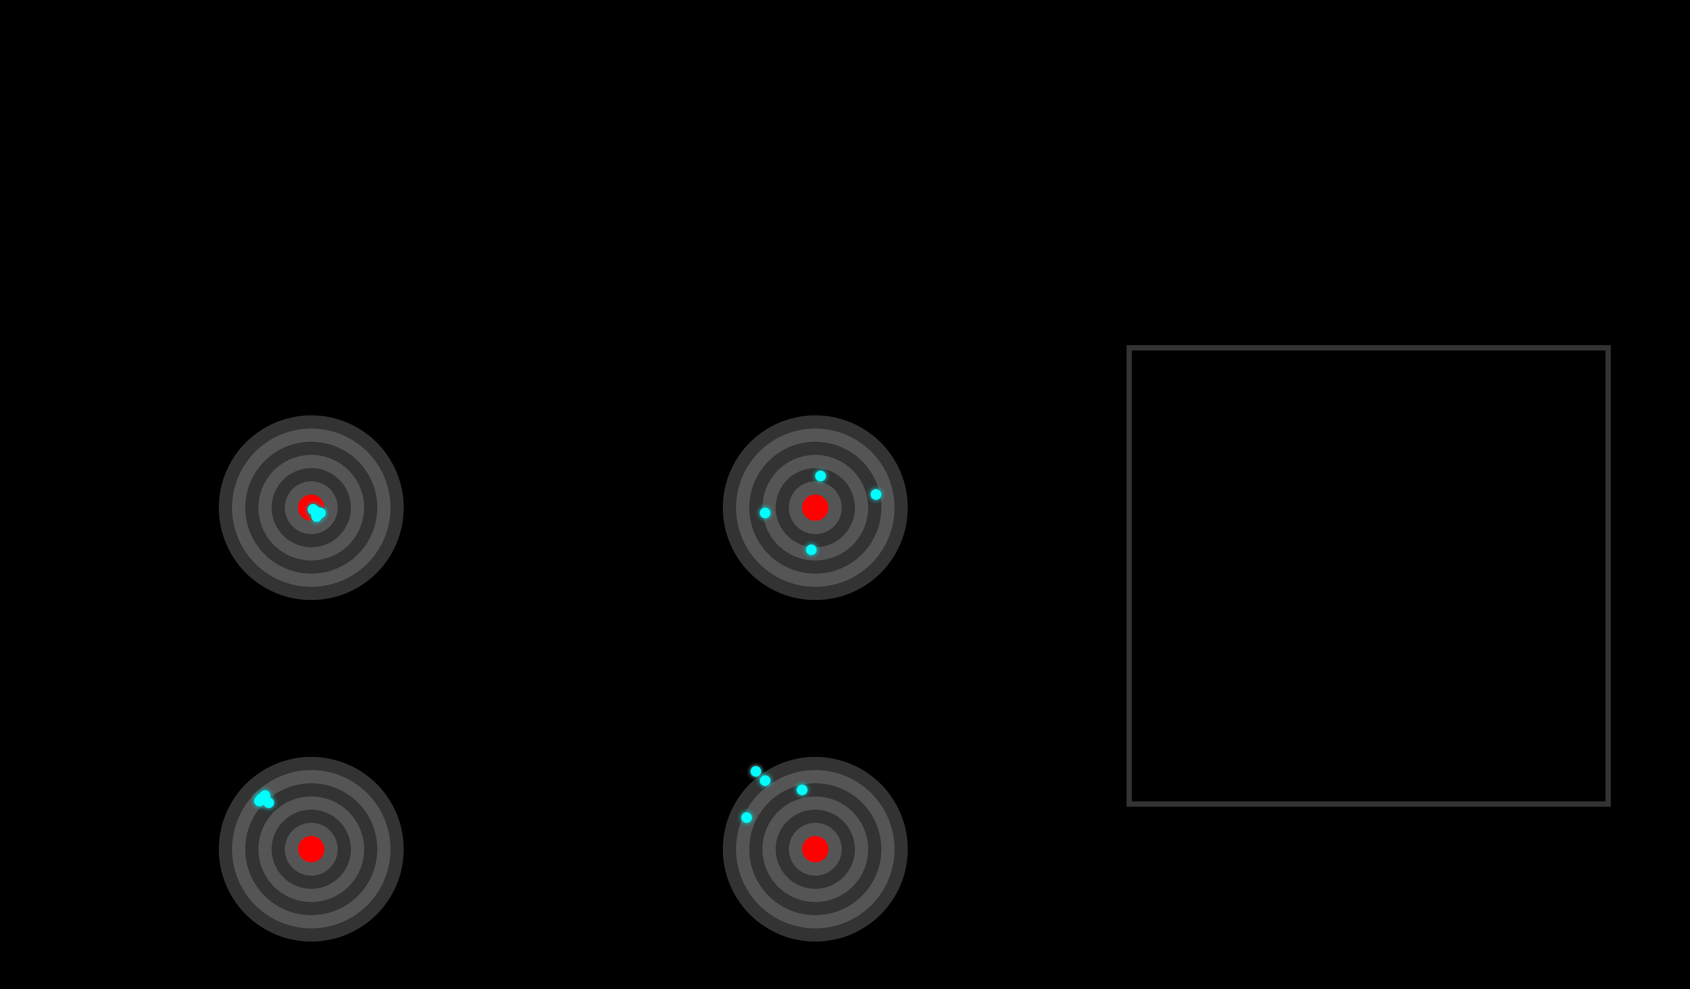

The Bullseye Analogy
Visualizing Bias & Variance
Low Bias, Low Variance (Ideal)
Low Bias, High Variance (Overfitting)
High Bias, Low Variance (Underfitting)
High Bias, High Variance (Worst Case)
In practice, we analyze error distributions (histograms/boxplots) to diagnose these issues.

Slide 15
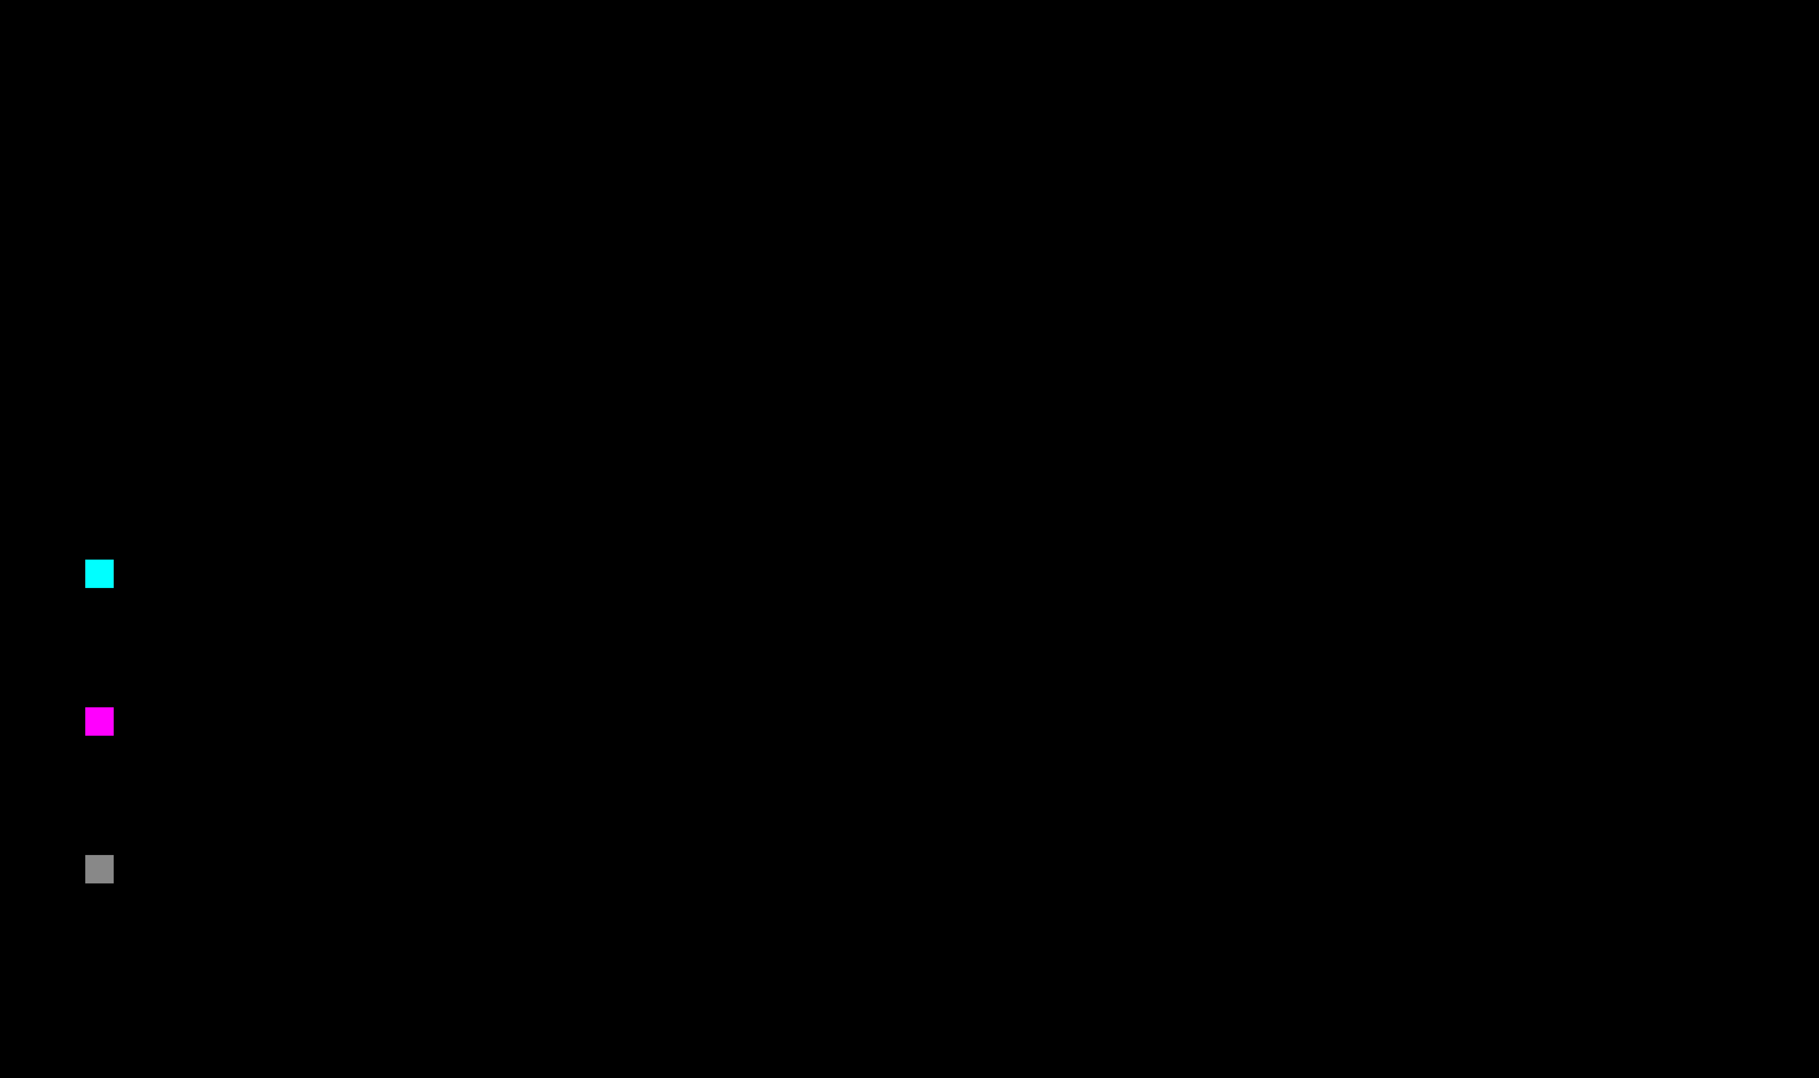
Error Decomposition
Where does error come from?
Error = Bias² + Variance + Noise
Bias²
Error from erroneous assumptions (Underfitting).
Variance
Error from sensitivity to small fluctuations (Overfitting).
Irreducible Error (Noise)
Inherent randomness in the data. Cannot be fixed by any model.
Visualizing the complexity and noise in real data.

Slide 16

Learning Curves
The MRI for Machine Learning Models
A diagnostic plot showing how model performance changes as the training set size increases.
The Axes
The Lines
X
Training Set Size
—
Training Score
How much data the model has "experienced".
How well the model fits the data it has seen.
Y
Score / Error
—
Validation Score
Accuracy, R², or Loss metric.
How well the model generalizes to new data.

Slide 17
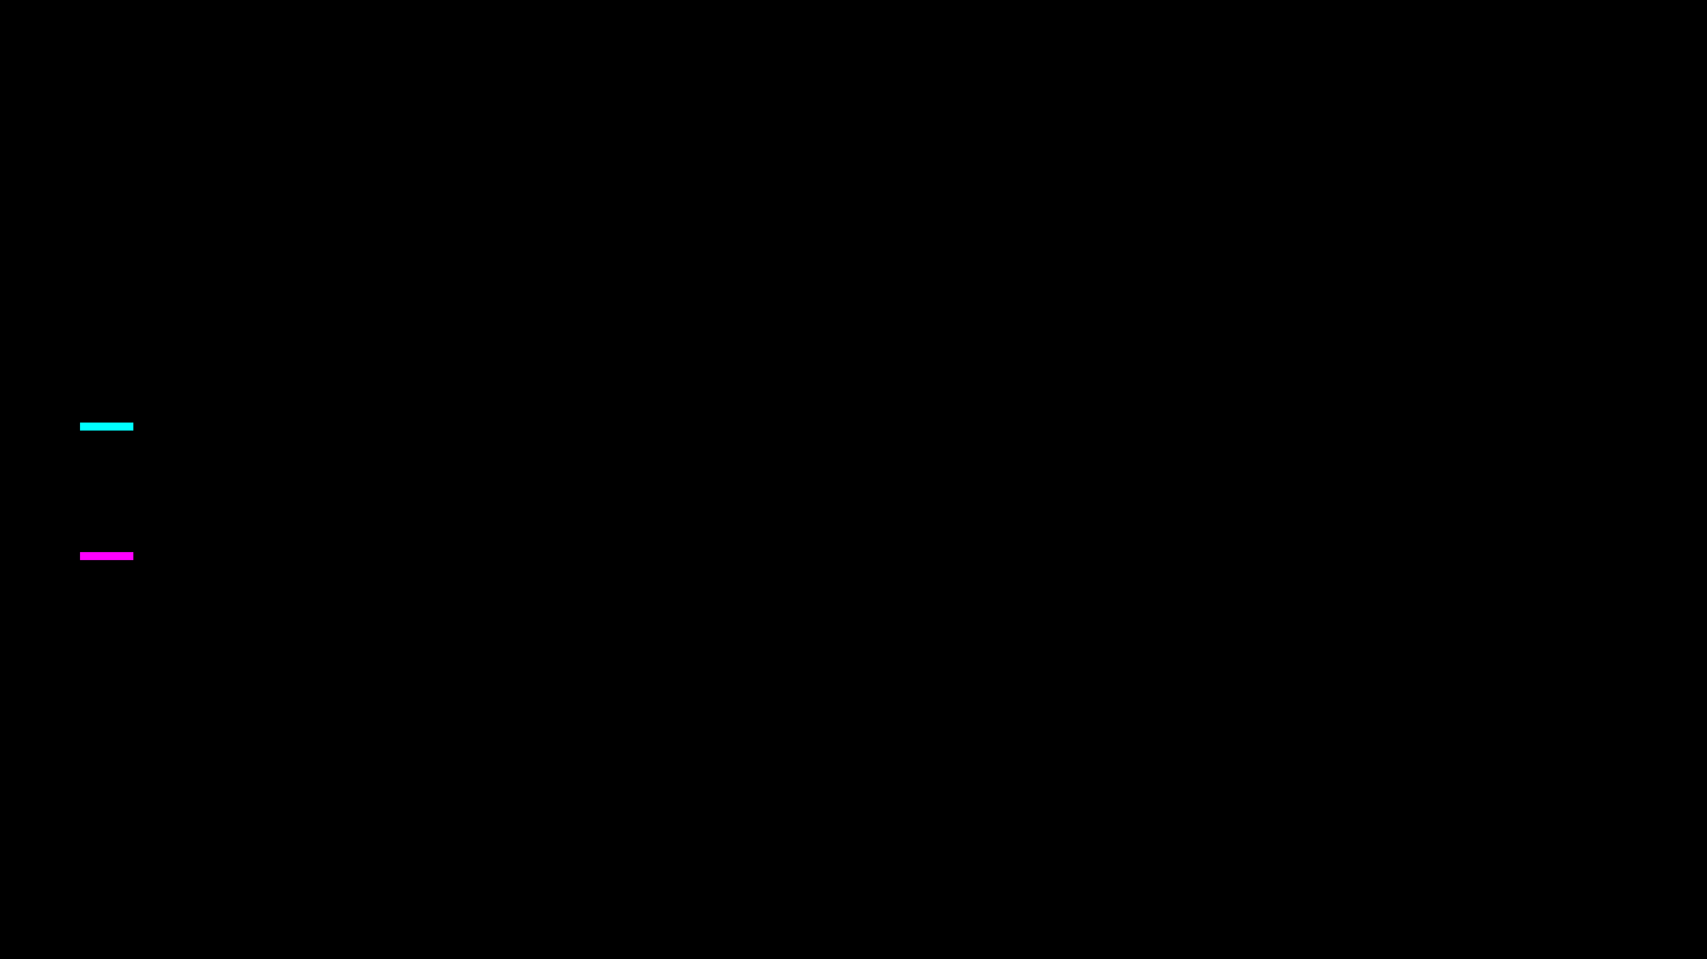
Reading Learning Curves
Interpreting the Gap
The Components
The Signals
Training Score
1. Check the Level
How well the model fits seen data.
Are both scores high or low? Low may imply bias.
Validation Score
How well the model generalizes.
2. Check the Gap
The vertical gap reflects variance.
3. Check Convergence
Do the lines converge with more data?

Slide 18
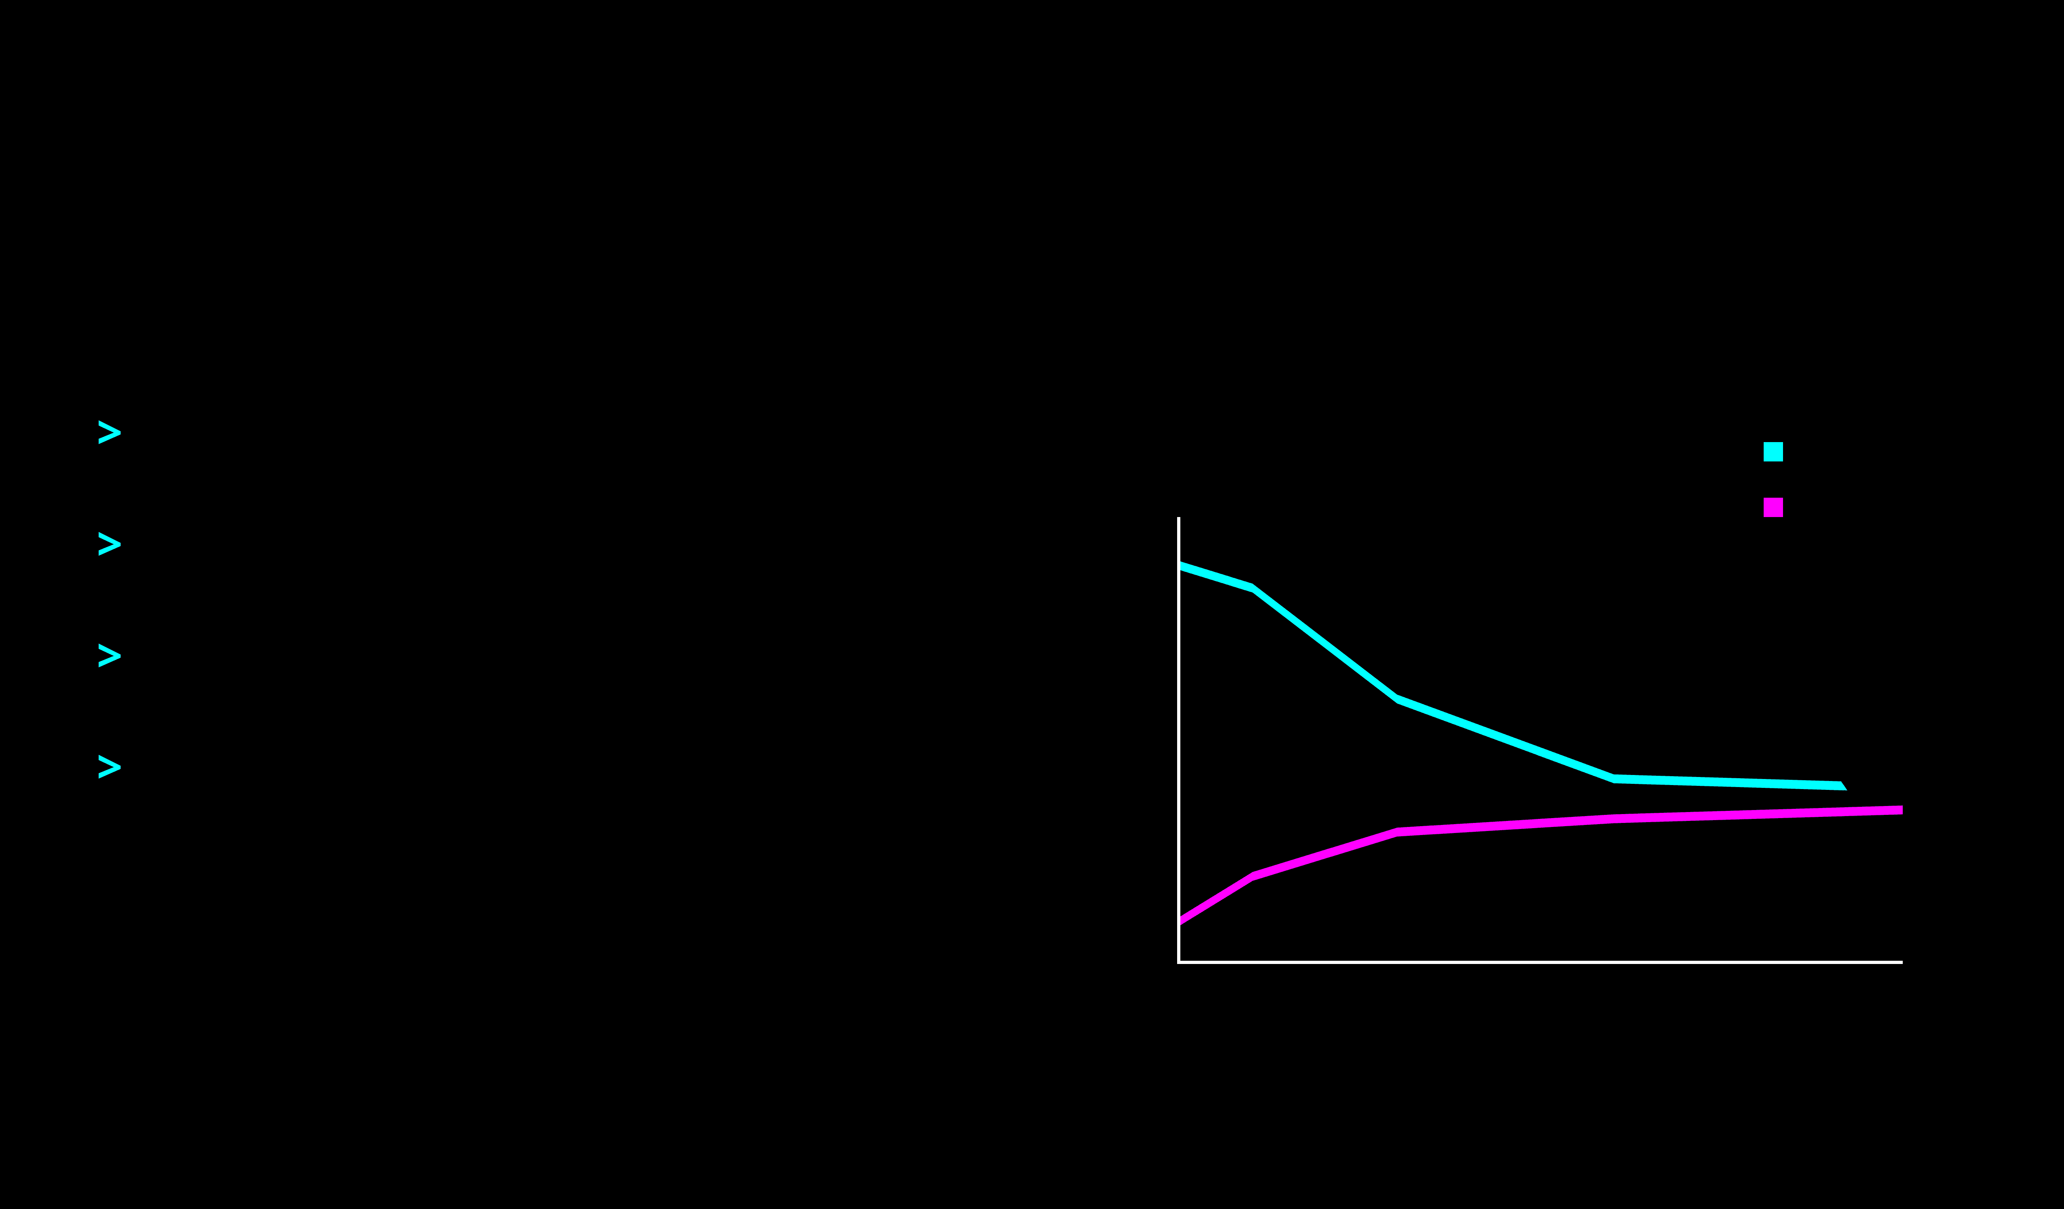
Underfitting Signature
High Bias Diagnosis
>
Training Score is
LOW
.
Learning Curve: High Bias
Training
Score
Validation
>
Validation Score is
LOW
.
>
Gap is
very small
.
>
Adding more data
does not help
(curves flatline).
Low Performance
The Fix: Increase Model Complexity (Add features, polynomial degrees).
Data Size

Slide 19
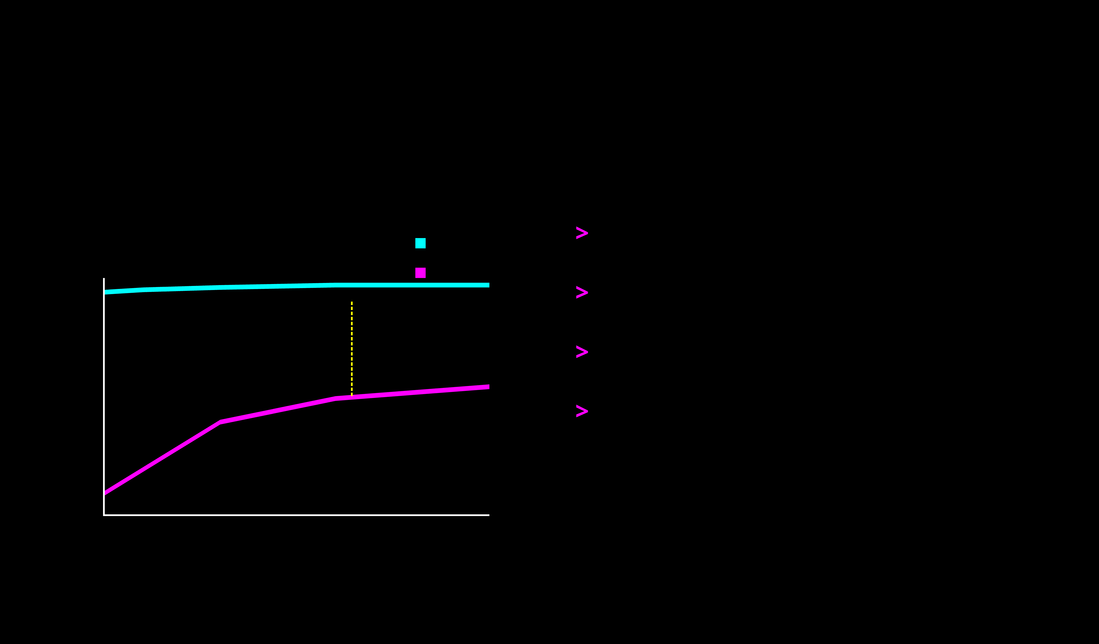
Overfitting Signature
High Variance Diagnosis
>
Training Score is
HIGH
(Memorization).
Learning Curve: High Variance
Training
Score
Validation
>
Validation Score is
LOW
.
LARGE GAP
>
Gap is
LARGE
.
>
Adding data
HELPS
(Validation score is rising).
Data Size
The Fix: Regularization, More Data, or Reduce Complexity.

Slide 20
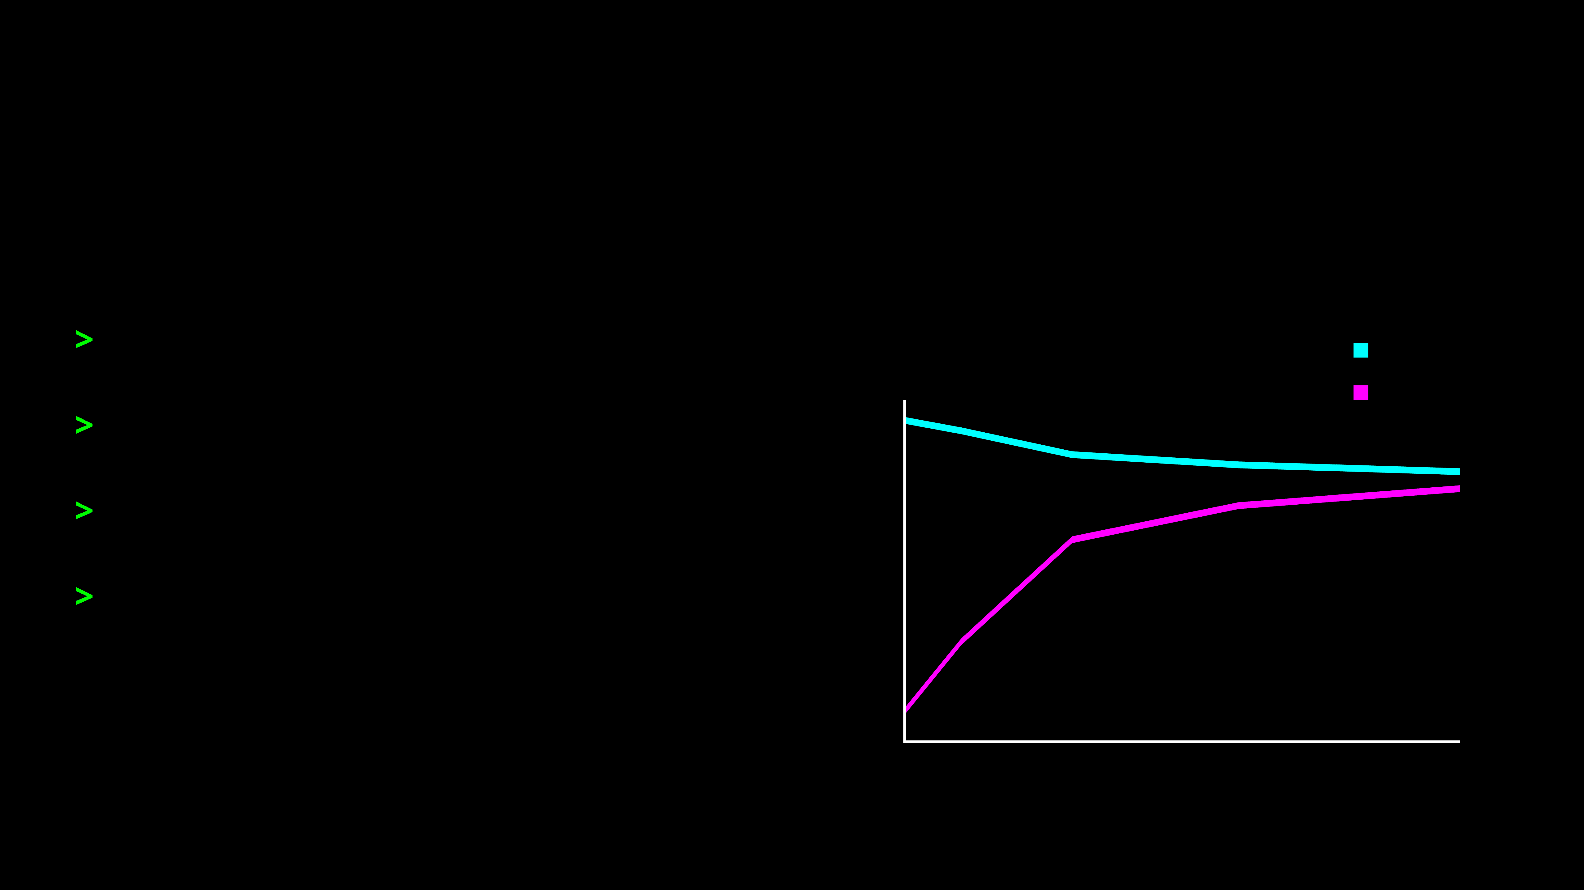
Good Fit Signature
The Goal State
>
Training Score is
HIGH
.
Learning Curve: Good Fit
Training
Score
Validation
>
Validation Score is
HIGH
.
>
Gap is
small
.
High Performance
>
Both curves converge at a high level.
The Result: The model generalizes well to new data without memorizing noise.
Data Size

Slide 21
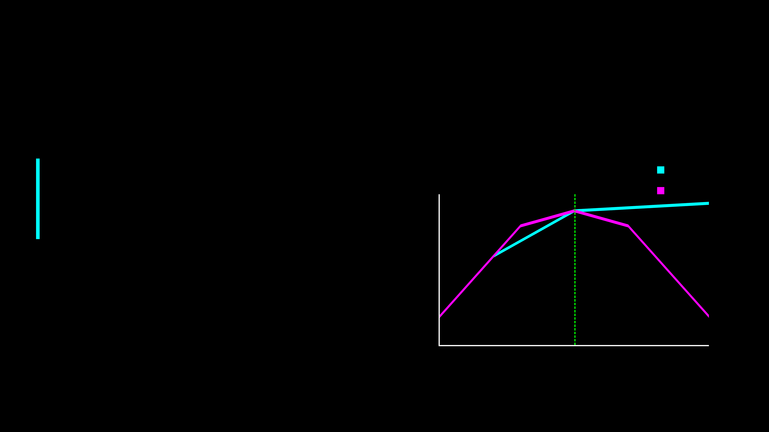
Validation Curves
Tuning for Complexity
A plot showing how model performance changes as we vary a hyperparameter (Learning rate, batch size, Epoch, L1/L2 regularization) (complexity).
Validation Curve
Training
Score
Validation
Sweet Spot
X-Axis:
Model Complexity (e.g., Tree Depth)
Y-Axis:
Model Score (Accuracy)
Complexity
Goal: Find the Peak (Sweet Spot)
Low (Bias)
High (Variance)

Slide 22
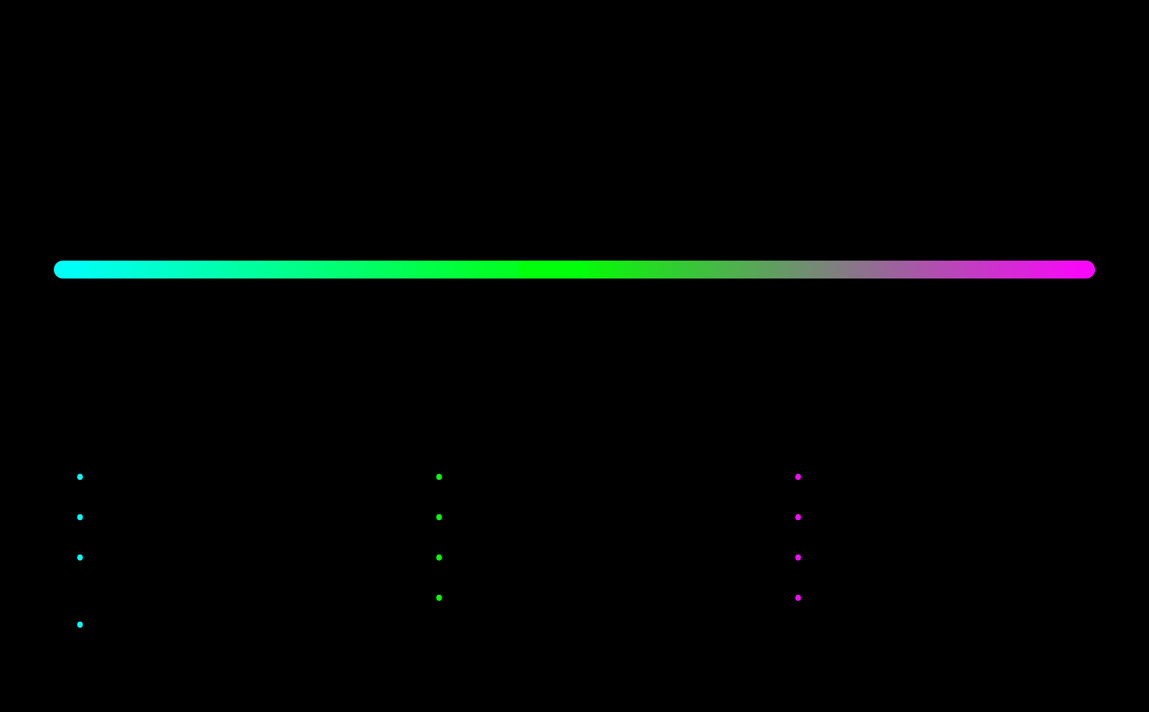
The Complexity Axis
Navigating from Simple to Complex
Simple
Complex
1
2
3
Underfitting
Optimal Fit
Overfitting
"Too Simple"
"Just Right"
"Too Complex"
•
High Bias
•
Low Error
•
High Variance
•
Misses patterns
•
Captures signal
•
Memorizes noise
•
Linear model on curved data
•
Ignores noise
•
High-degree polynomial
•
Generalizes well
•
Too many features
•
Few features

Slide 23
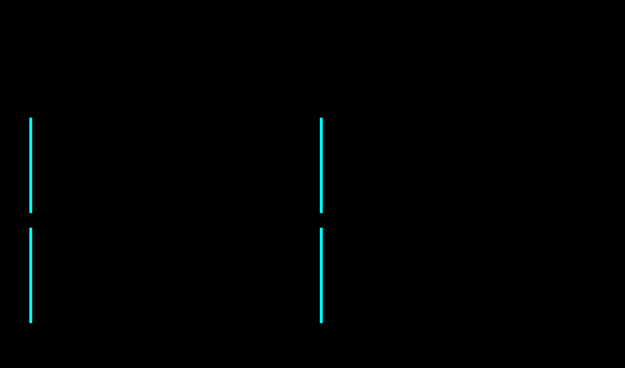
Fixing Underfitting
Strategies to Reduce Bias
Increase Complexity
01
02
Add Features
Switch to a more powerful model (e.g., from Linear Regression to Decision Trees or Neural Networks).
Create Polynomial Features, interaction terms, or collect more relevant data columns.
03
Train Longer
04
Reduce Regularization
For iterative algorithms (like Gradient Descent), increase the number of epochs/iterations.
Decrease the penalty term (Lambda/Alpha) to allow the model to fit the data more closely.
Goal: Give the model enough capacity to capture the underlying patterns.

Slide 24
Fixing Overfitting
Taming High Variance
01
Get More Data
More examples enforce generalization over noise.
02
Simplify the Model
Reduce degrees, features, or tree depth to limit complexity.
03
Regularization
Penalize large weights (L1/L2) to constrain the model.
04
Early Stopping
Stop training at validation peak to prevent memorization.

Slide 25

L1 Regularization (Lasso)
The Feature Selector
The Mechanism
Effect on Weights
Adds a penalty equal to the Absolute Value of the coefficients.
Age
0.85
Zip Code
0.00
The Superpower
It can shrink coefficients completely to ZERO.
Income
1.24
Shoe Size
0.00
When to Use
When you suspect only a few features are actually important (Sparse Models).
Automatic Feature Selection

Slide 26
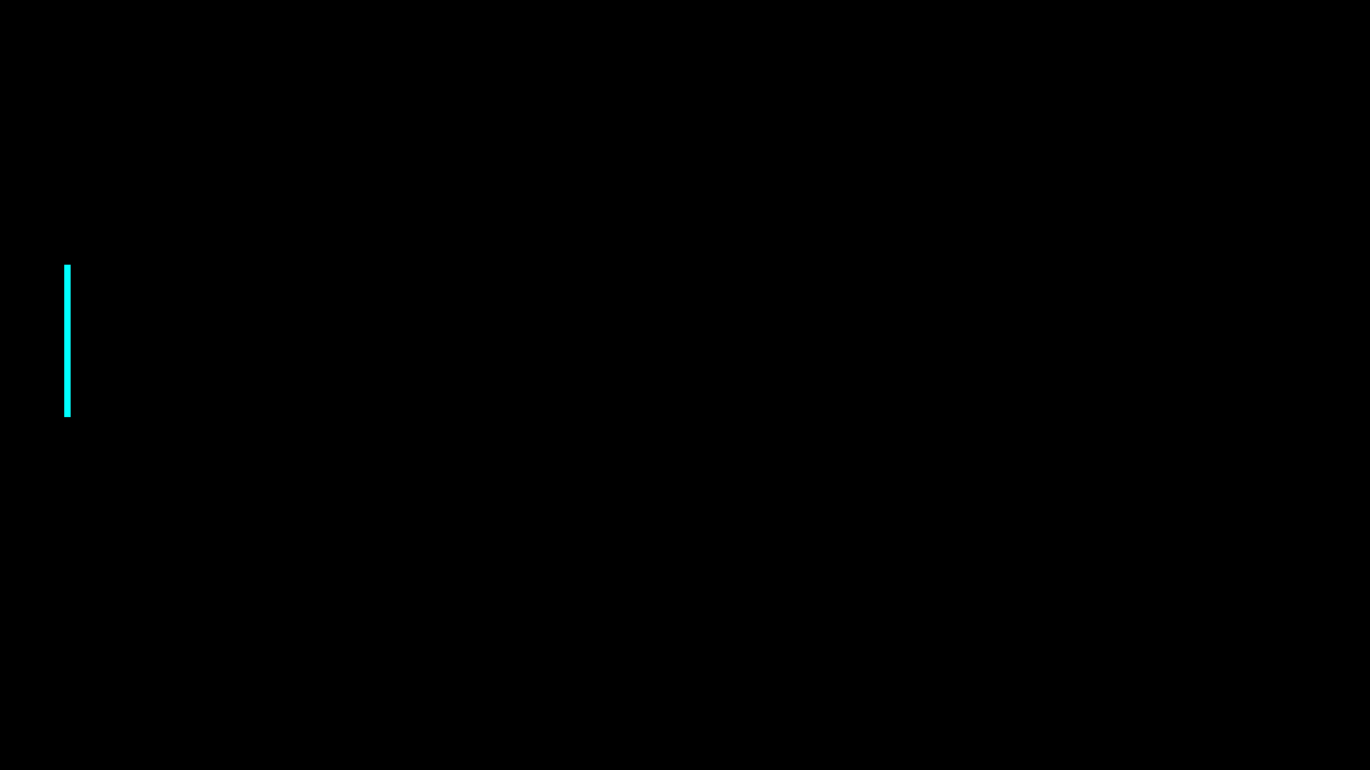
L2 Regularization (Ridge)
The Weight Shrinker
📉
The Mechanism
Shrinks Weights: Limits feature impact; prevents dominance.
Adds a penalty equal to the Square of the magnitude of coefficients.
🚫
No Zeroing Out: Coefficients rarely become exactly zero.
The Analogy
✅
"Like a rubber band pulling coefficients toward zero—never snapping to zero."
Best Use Case: Dense data with many small contributors.
Penalty Term: λ * Σ(slope)²

Slide 27
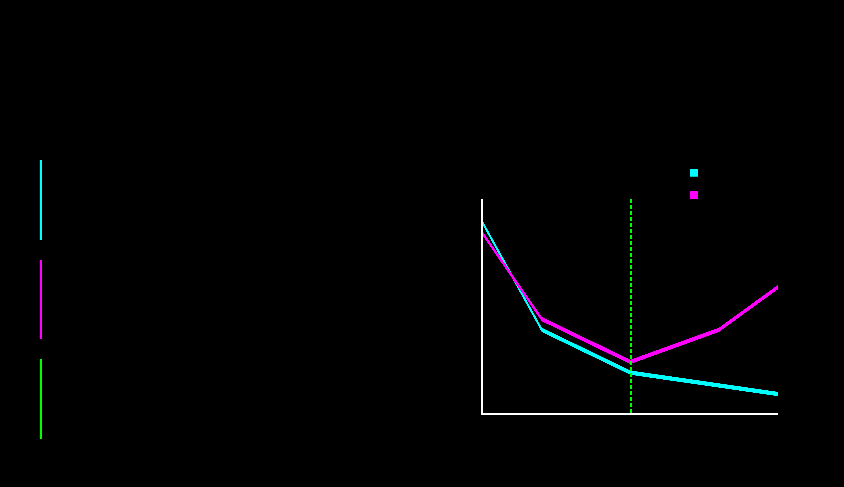
Early Stopping
The "Quit While You're Ahead" Strategy
1. Monitor
Error vs. Epochs
Training Error
Error
Validation Error
Track validation error after every epoch (training cycle).
STOP HERE
2. Detect
Notice when validation error stops decreasing and starts to rise.
3. Stop
Halt training immediately to prevent the model from memorizing noise.
Underfitting
Overfitting
Epochs

Slide 28
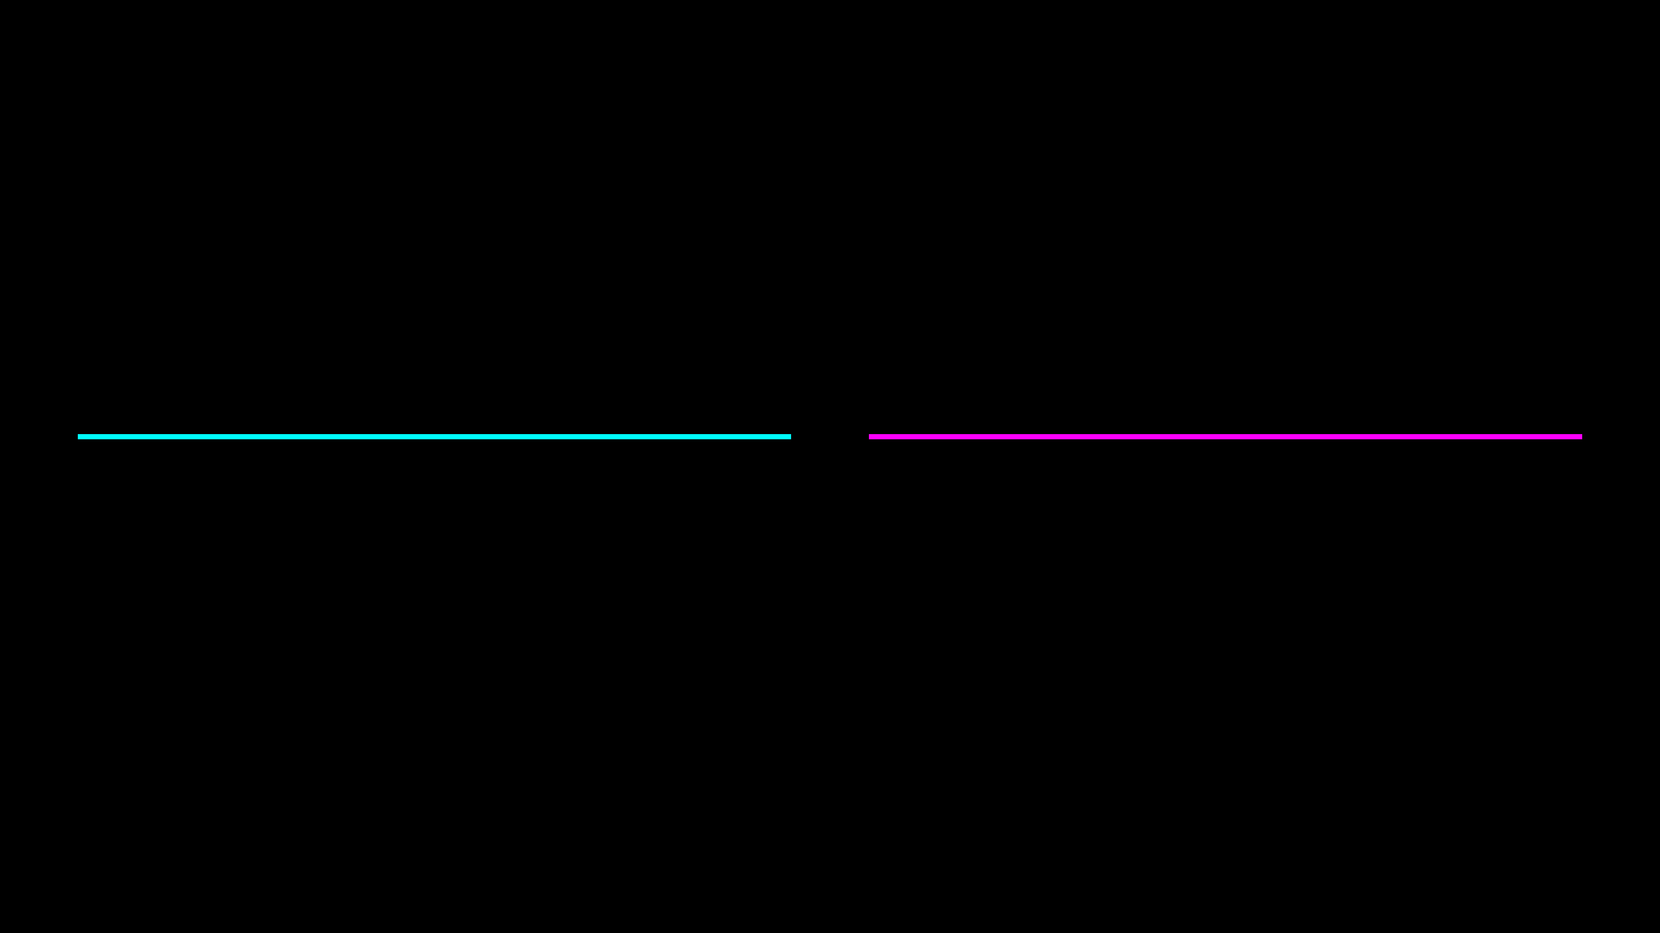
Dropout & Ensemble Preview
Advanced Variance Reduction
Dropout
Ensembles
(Neural Networks)
(Tree-Based Models)
Randomly drop neurons per pass to discourage reliance on single features.
Combine multiple models; errors cancel, signal remains.
The Mechanism
The Mechanism
Forced robustness via random noise.
Crowd wisdom reduces variance.
Coming Up: We will dive deep into Ensembles (Random Forests) in Module 09.

Slide 29
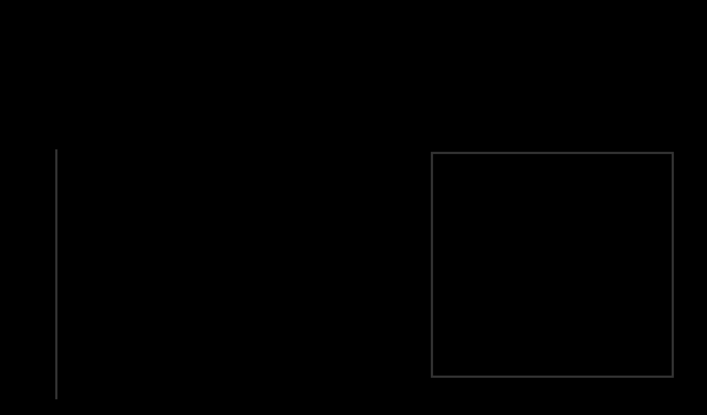

Decision Framework
The Diagnosis Checklist
Check Training Score
1
Is it low? YES: High Bias. Increase Complexity. NO: Proceed to Step 2.
Check Validation Gap
2
Is the gap large? YES: High Variance. Add Data / Regularize. NO: Proceed to Step 3.
Evaluate & Deploy
3
If both scores are high and the gap is small, you have a Good Fit.
Systematic diagnosis leads to robust models.

Slide 30
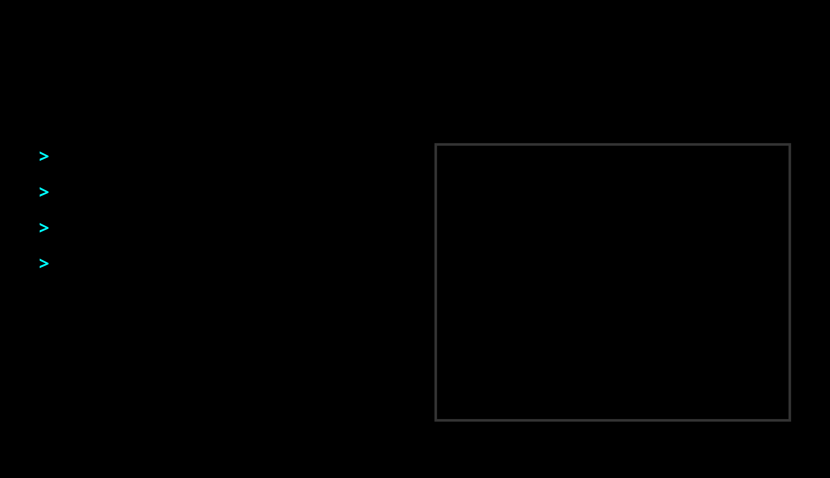

Lab Preview
Hands-on: Diagnosing & Fixing Models
>
Diagnose
via learning curves.
>
Ridge/Lasso
Regularization
.
>
Visualize the
Sweet Spot
.
>
Compare polynomial degrees for fit.
We'll tune a failing model to perfection.
Next Step: Practical Application

